Slide 1
streets/(ART) part 1

Slide 2
streets/(ART) part 1
Every Inside Has an Outside.
It is a Game.
Things Want to be Your Friend.
Once You Start Looking, They’re Everywhere.

Slide 3
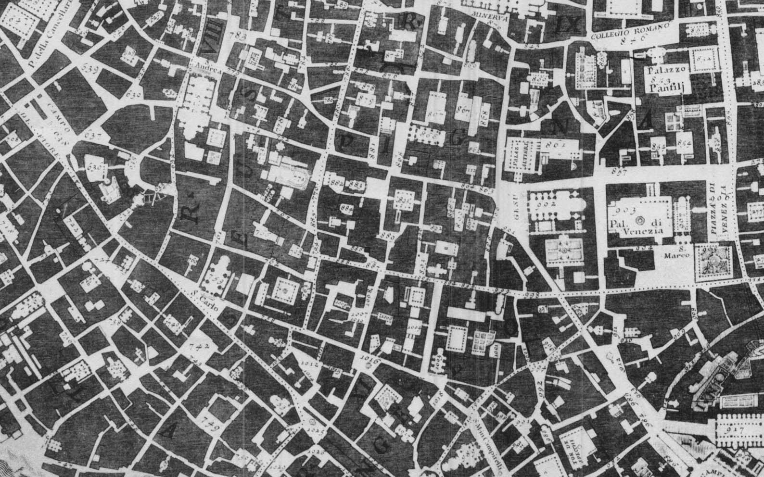
Every Inside Has an Outside.

Slide 4

It is a Game.

Slide 5
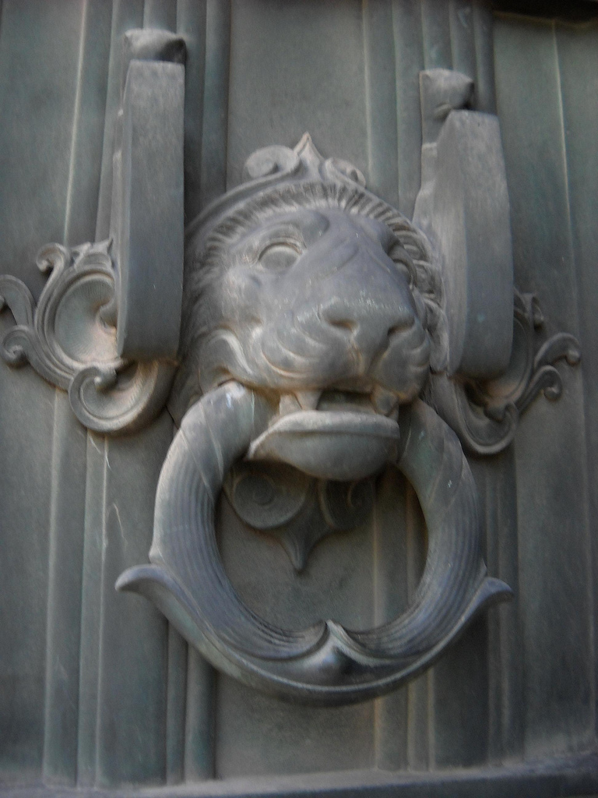
Things Want to be Your Friend.

Slide 6
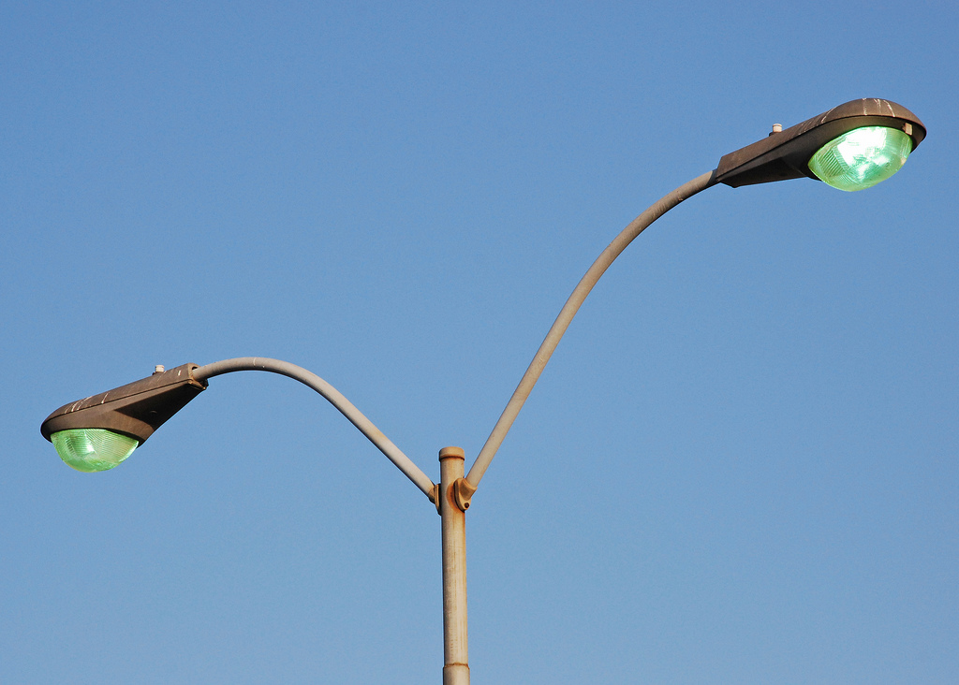
Once You Start Looking, They’re Everywhere.

